Slide 1
Development of Algorithm for code standardization/modularization of GK-2A meteorological data processing system
Ha-Yeon Choi*, Sang-Ho Bang, Byoung-Guk Kang,
Do-Hyeon Gil, Seong-Seok Yong, Geon-Ho Lee
Notes:
We have carried out ~

Slide 2
Contents
Ⅰ. Introduction
Background ----------------------------------------- 3
Purpose ---------------------------------------------- 7
Flow of development ------------------------------ 11
Common Test Bed (MATE)----------------------- 13
Improvement Test Bed (MATE)------------------ 14
Common Module------------------------------------ 15
Standardization-------------------------------------- 18
Verification of algorithm--------------------------- 19
Ⅱ. Main
Operation & Service ----------------------------- 21
Forward Plan --------------------------------------- 22
Reference -------------------------------------------- 23
Ⅲ. Conclusions
Notes:
These are the contents of my presentation.
Starting with Introduction, I will take you through the background and purposes.
Followed by Main section and the conclusions.

Slide 3
Ⅰ
Introduction
Background
Purpose

Slide 4
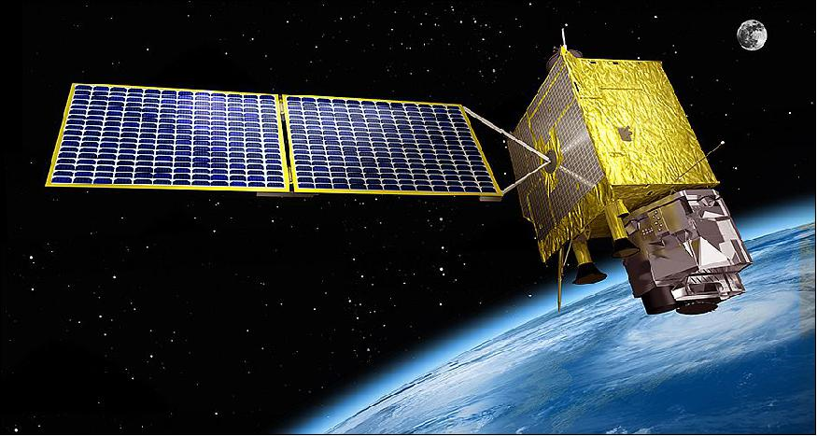
Introduction
01
Background
GEO-KOMPSAT-2A Overview (1/2)
Purpose
Meteorological remote sensing
Space weather
Payload
AMI (Advanced Meteorological Imager)
KSEM (Korean Space Environment Monitor)
Ground segment
Outline
Level 2 product algorithms
Meteorological/space weather data processing system
Mission objective
Enhancing forecast/climate monitoring
Generation of the baseline meteorological products
Dissemination of GK-2A data via satellite broadcast system, LRIT/HRIT/UHRIT
Supporting satellite operation
< GK-2A >
Notes:
This is a general overview of our recent launch GK-2A.
The purpose of the satellite is meteorological remote sensing and space weather monitoring.
As this ground segment requires various functions, it needs Satellite control and data management & service system along with level 2 product algorithm and Meteorological/space weather data processing system.
The Ground segment has several key aspects.
In particular, this function(LRIT/HRIT/UHRIT) enables global services.

Slide 5
Introduction
01
Background
GEO-KOMPSAT-2A Overview (2/2)
Coverage
FD, NHFD, North-East Asia
Korea Peninsula
Observation capability
 | Value
Spectral range [μm] | 0.47 – 13.3
Spectral Resolution [nm] | 400 - 1000
Bands | 16
< Spectral range of AMI >
Notes:
The GK-2A observation mode is
Observation period is different according to observation mode.
FD(Full Disk) takes 15min
NHFD(Northern Hemisphere Full Disk) 5 min
Korea Peninsula(Local Area(LA)) 30 sec
This figure show the spectral range of AMI.

Slide 6
Introduction
01
Background
GEO-KOMPSAT Comparison (1/2)
 |  | COMS | GK-2A
Number of meteorological product |  | 16 | 52
Number of channel |  | 5 | 16
Spatial resolution [km] | Visual | 1 | 0.5 - 1
 | IR | 4 | 2
Observation cycle [times/hour] |  | 8 | 24
Data transfer rate [Mbps] |  | 2.6 | 60
Mission Life [years] |  | 7 | 10
Notes:
The GK-2A launched on December 5, 2018 can produce 52 meteorological products (23 major products and 29 additional products) using 16 channels.
The GK-2A has greatly improved performance compared to coms.
The development of the algorithm of commercial meteorological products has been done through collaboration of industry, academia and research.
University and research developed primitive algorithms, and soletop has implemented algorithm testing environment configuration and standardization / modularization.

Slide 7
Introduction
01
Background
GEO-KOMPSAT Comparison (2/2)
Improvement of spatial resolution (4 times higher)
Increase of observation frequency (based on 1 hour)
Visible
1㎞
0.5㎞
Infrared
4㎞
2㎞
COMS
GK-2A
30 times
(2 min)
30 times
(2 min)
1 time
(3 hours)
6 times
(10 min)
4 times
(15 min)
4 times
(15 min)
Entire Earth(full disk)
Asia-Pacific Region
Korean Peninsula
Increase of the number of channels (5 channels →16 channels)
Increase of output
(16 types→52 types+α,; creation of 8 new types of space weather output)
COMS
GK-2A
10
channels
5types
19types
5types
16types
4 channels
(color)
Cloud/Precipitation
Radiation/Aerosol
1 channel
4channels
(monochrome)
3types
6types
0channel
2 channels
3types
11types
Visible channels
Near-infrared channels
Infrared channels
Atmospheric motion/conditions
Surface information
Notes:
This figure makes it easy to see how much performance improvements have been made.
The spatial resolution is four times better than COMS.

Slide 8
Introduction
02
Purpose
Needs of standardization/modularization
x 3.25
Notes:
This graph shows the need for this project.
The number of codes to handle meteorological products increases in proportion to the increase in the types of products.
Therefore, there is a need for standardization / modularization for module linkage and code management.

Slide 9
Introduction
02
Purpose
Maintenance & Management of Algorithm
Primitive code 1
Group A
Primitive code 2
Standardization
/Modularization
Group B
Primitive code 3
Group C
Notes:
This figure is the purpose of this project.
Algorithm developers register primitive code at Common Test bed.
Soletop converts primitive code into commercial code by applying standardization/modularization technique.
We have derived Common modules through primitive algorithm modularization and have carried out standardization to ensure ease of maintenance in the future.

Slide 10
Introduction
02
Purpose
Commercialization of Algorithm
Common Test Bed
Registration code
Standardization
/Modularization
Verification
Simulator
Notes:
This process is commercialization of algorithm.
Algorithms have been developed for the generation of meteorological products, and a common test bed has been developed to apply them to production.
Soletop Co., Ltd. has carried out environment and function improvement so that the algorithm test / verification can be smoothly performed in a common test bed.

Slide 11
Ⅱ
Main
Flow of development
Common Test Bed(MATE)
Improvement of MATE
Common Module
Standardization
Verification of Algorithm

Slide 12
Main
01
Flow of development (1/2)
Development cycle
algorithm code
standardization/modularization
Analysis code & algorithm preferred relationships
Primitive Code
standardization
/modularization
code
Dedicated module extraction & making
Common module extraction & making
Improvement Common module
Add new common module
Algorithm
developer
Check standardization/modularization code
standardization/modularization
ETRI, ㈜SOLETOP
Notes:
Algorithm developers register primitive code at MATE.
Soletop converts primitive code into commercial code by applying standardization/modularization.
However, if the developer improves the algorithm, the changed code is reviewed and reflected in the existing standardized code.
If the updated code identifies a number of functions of the same function, it has been added as a new common module.
when code is updated, we retry.
And the development cycle is repeated.

Slide 13
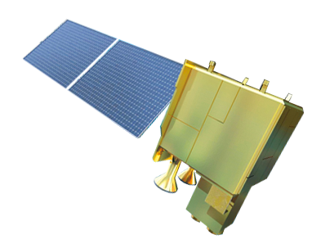
Main
01
Flow of development (2/2)
GK2A Algorithm Modularization / Standardization Major tasks (2014 ~ 2018)
Launch (2018.12.05)
2014
2015
2016
2017
2018
IOT
Operation
Algorithm Development Coding Guidelines v1.0
Development of Common Test Bed
Algorithm Development Coding Guidelines v2.0
Development of Common Test Bed
Development of data comparison tools
Development of coding guidelines verification tools
Advisory on coding technology
Development of common module v1.0
Analysis of Algorithm Preferred Relationships
Development of 23 major product algorithm code standardization/modularization
Development of 23 major product verification code standardization/modularization
Improvement of verification tools
Developer training
Development of common module v2.0
Analysis of Algorithm Preferred Relationships
Improvement of 23 major product algorithm code standardization/modularization
Improvement of 23 major product verification code standardization/modularization
Development of 29 additional product algorithm code standardization/modularization
Development of 29 additional product verification code standardization/modularization
Development of Pre/Post processing Algorithm standardization/modularization
Developer training
Extraction of Common module & Pre/Post processing Algorithm code standardization/modularization
Improvement of 23 major product algorithm & verification code standardization/modularization
Improvement of 29 additional product algorithm & verification code standardization/modularization
Development of Utilization product Algorithm code standardization/modularization
Support of algorithm update
Expansion of Common module, Conversion from AHI to GK2A(AMI)
Test of Algorithm
(standardization/modularization)
Support of common test bed operation
Notes:
This timeline is work list by year.
The first step is distribution of algorithm development coding guidelines so that developers can follow.
This step is effective for code update & change.
We suggest rules for easy updating through algorithm development coding guidelines.
Next is development of common test bed & utilities. This step is environment configuration of development algorithm.
It provides tools such as comparing data of GK-2A's simulated outputs with data of other reference materials, judging violation of guidelines.
The code standardization/modularization is divided into major products and additional products.
The development of major products codes was the priority.
The IOT(In Orbit Test) of GK-2A will continue through 20 July.
The GK-2A forecasting service will start at the end of July.

Slide 14
Main
02
Common Test Bed (MATE)
Needs of common test bed
Researcher
01
Development status and information sharing
SOLETOP
Developer
02
Algorithm source code configuration management
03
Algorithm development and verification environment
Notes:
We have provided developers and researchers with useful features that a common testbed(MATE(Meteorological Algorithm Testbed Environment)) offers.
Researcher (KMA, NMSC), developer (professionals from university), and soletop need a common ground to enable shared thinking.
We all come together in a common platform and facility the test bed operations named ‘MATE’.
The common operations involve:

Slide 15
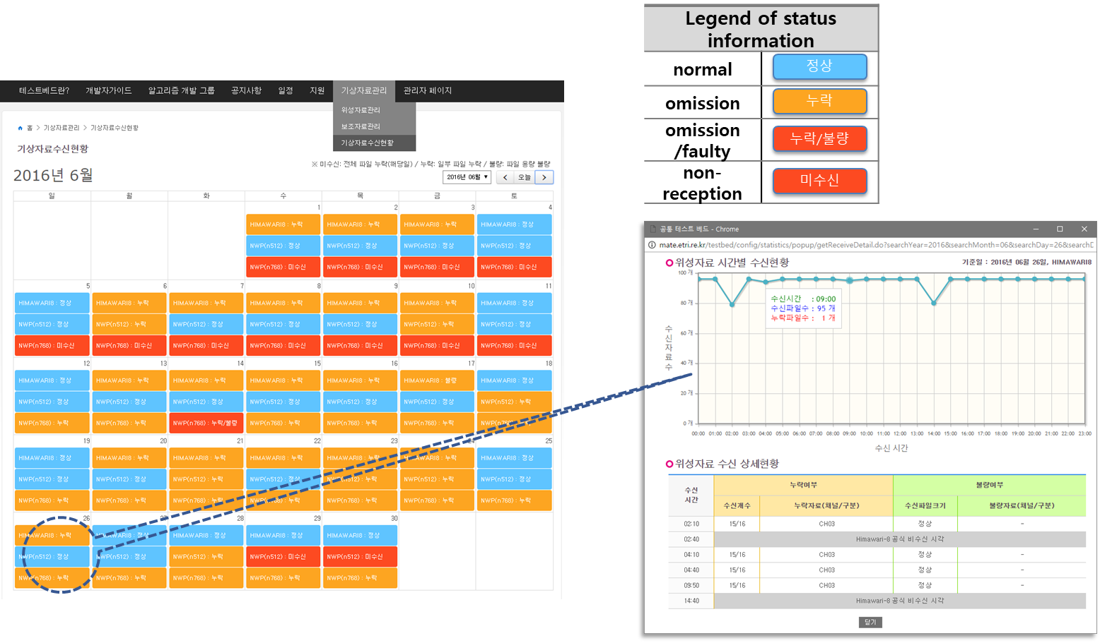
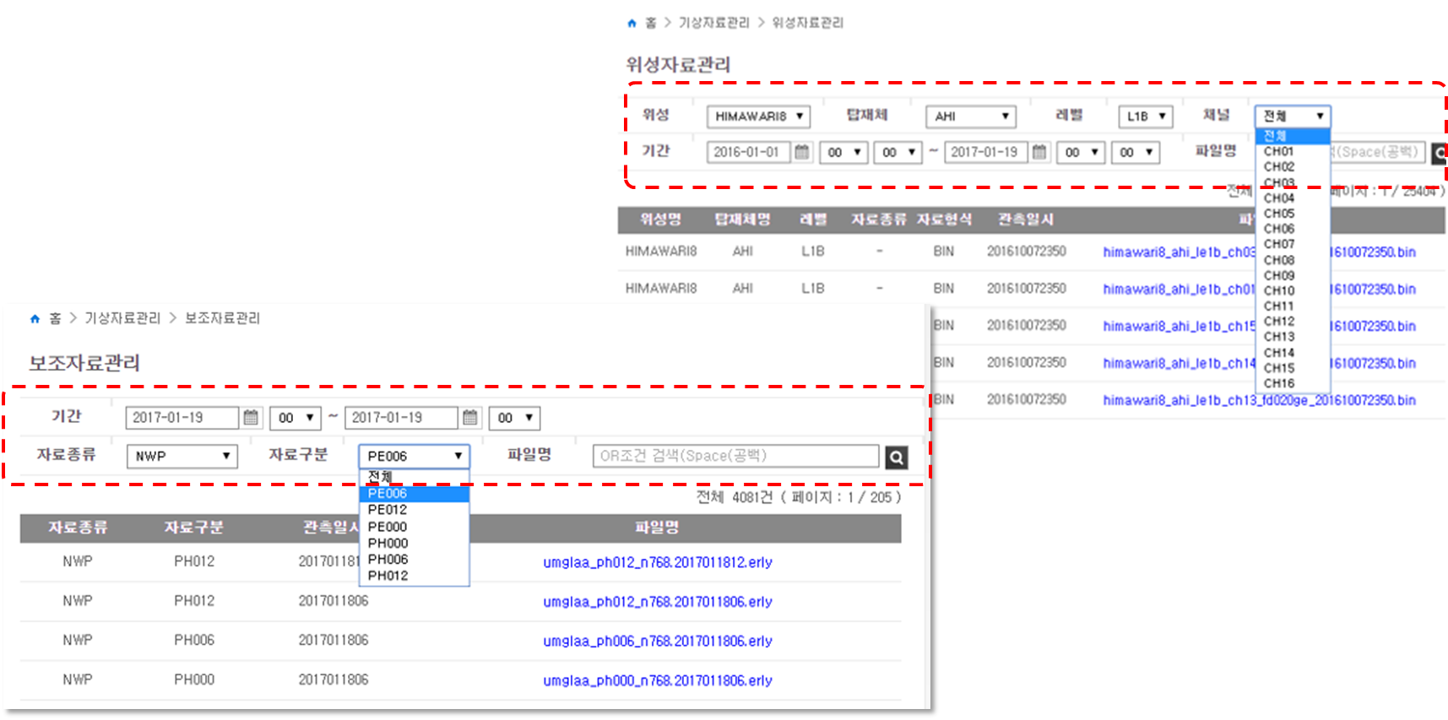
Main
03
Improvement of MATE
Improvement process
Requirements
Maintenance
Algorithm developer
Researcher
SOLETOP
Notes:
SOLETOP has continuously improved MATE.
We have received improvement requests from developers and researchers.
We have reflected the improvement requirements.

Slide 16
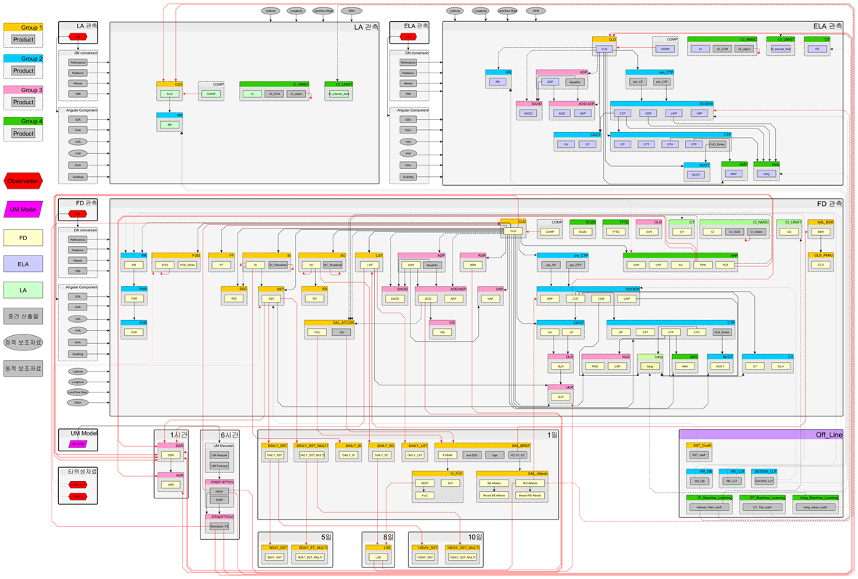
Main
04
Common Module
Analysis of Algorithm Preferred Relationships (1/2)
Notes:
The analysis of the precedence relationship is based on the analysis of input and output relations of 23 major and 29 additional output algorithms.
The algorithms for the LA area, the ELA(extended local area) area, and the FD area are shown, and the order of execution is shown from top to bottom of each area.
Blocks with each header are algorithms, and the inner box is the output of the algorithm.
If you select a block, you can see the output of the preceding algorithm.
When modularization / standardization is performed, it is defined that a module having the same input / output format as the preceding algorithm can be implemented.

Slide 17
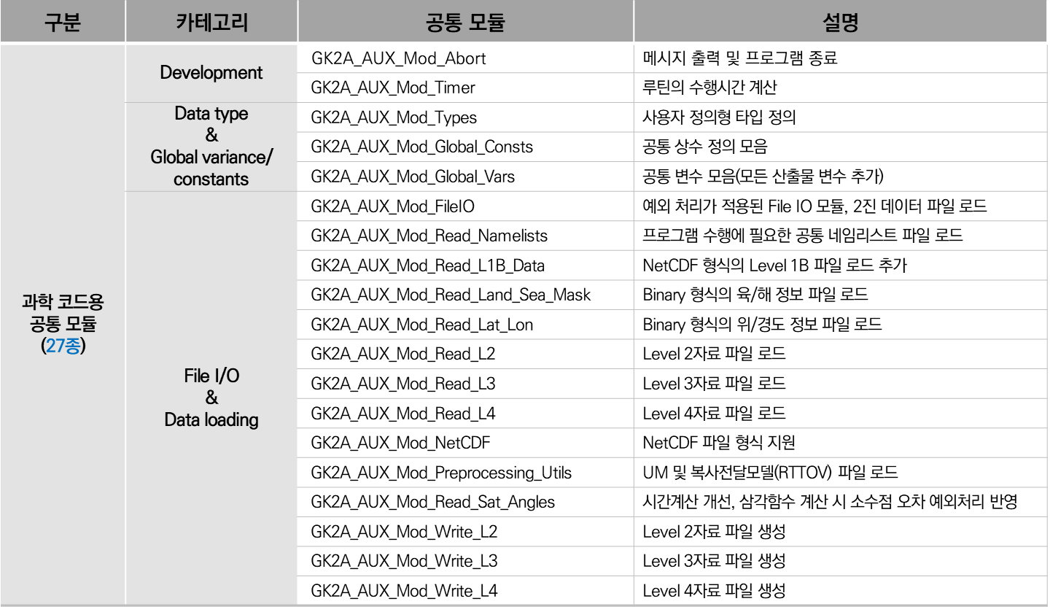
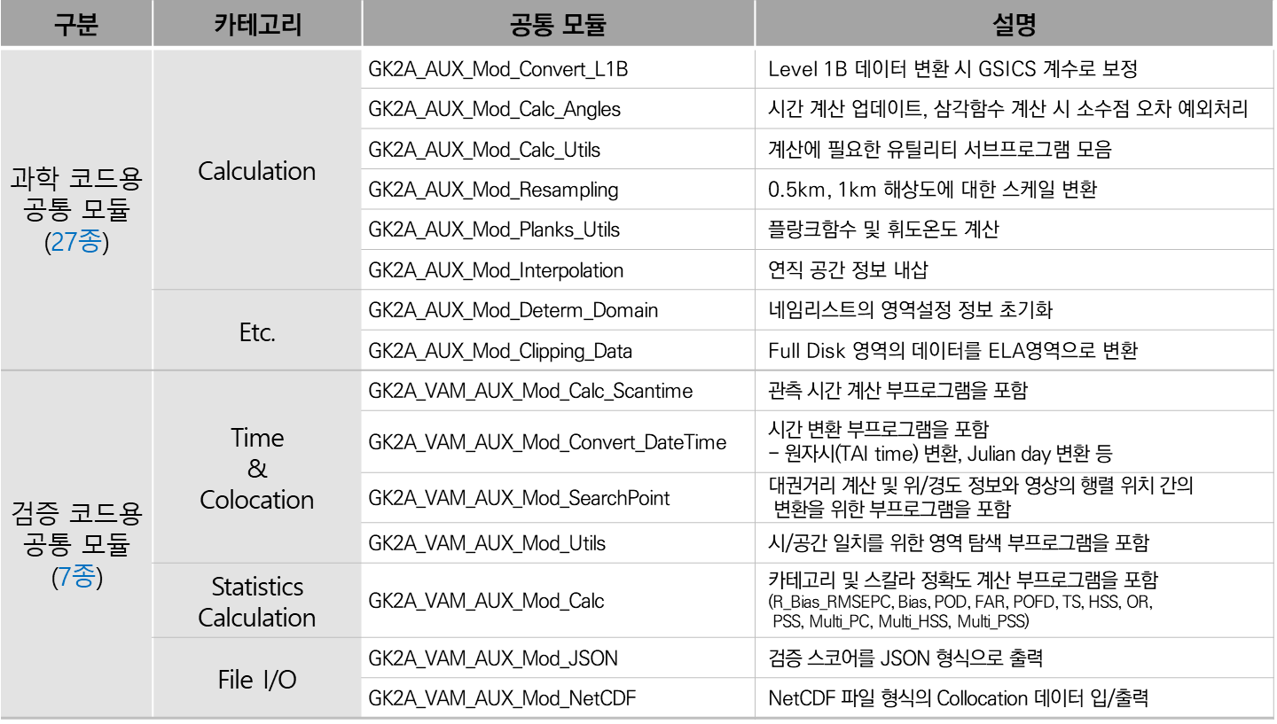
Main
04
Common Module
Analysis of Algorithm Preferred Relationships (2/2)
Common module of Algorithm
Message output & Program termination
Common module of Verification code
Calculation time & colocation
Data type & Global variance/constants
File I/O & Data loading
Calculation(meteorological processing)
Statistics calculation
File I/O
Notes:
This list is category of common module.

Slide 18
Main
04
Common Module
Effect of extraction in primitive code
Structuring the program
Increased code reusability
Convenience of maintenance
Extraction
Input
/Output
Same Function
Exception
processing
Basic calculation
Uniqueness
Notes:
In each algorithm, common module is extracted by classifying it as input/output, same function, exception processing, basic calculation, and algorithm specific module.
Through modularization, program structure, code reusability and convenient maintenance were enhanced.
Program structure was much simplified and quickly accessible. If programmer wants to re-use the code for other specific applications, the process was very easy to re-track.
By this technique, the maintenance has been a much convenient and less time consuming.
In addition to this, the readability of the code is improved.

Slide 19
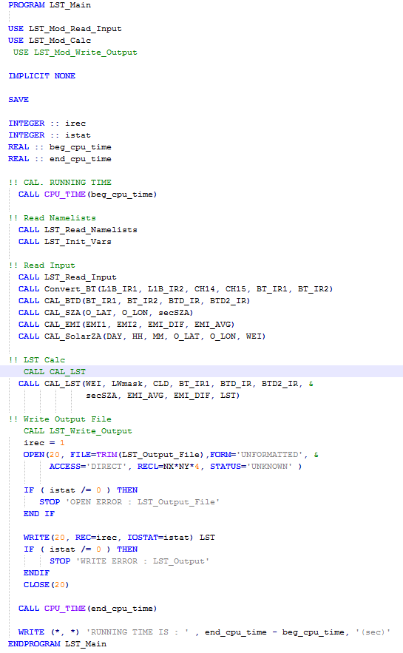
Main
05
Standardization
Effect of standardization in primitive code
[Doxygen header remark]
[Primitive Code(LST)]
Standardization
[Blocking of syntax]
Notes:
This is the effect of standardization in primitive code.
We suggest input/output format, procedure structure, rules for transferring variables between modules, declaration of common constants, rules of blocking and writing executable statements through algorithm development coding guidelines.

Slide 20
Main
06
Verification of Algorithm
Verification process
Himawari-8
Terra
.
.
.
Matching of Time & Space
Calculating
Verification Score
Result
Verification Score
Notes:
The reference will vary depending on the nature of the meteorological product.
The verification code was analyzed and patterned by the verification program for all 52 products.
All verification codes consist of two programs: space-time matching and verification score calculation.
The time-space Matching Program receives the GK-2A output and reference data.
Program performs calculations for time and space matching using the input and outputs (동사) the result file.
The verification score calculation program receives the space time result data, calculates the verification score and outputs(동사) the statistical information.

Slide 21
Ⅲ
Conclusion
Ground segment operation
Weather Broadcasting Service
Future Plan
Reference

Slide 22
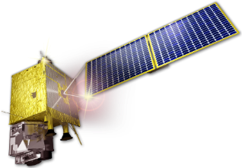
Conclusion
01
Ground segment operation
User
L-band : Low speed/high speed meteorological broadcasting
X-band : Super-high speed meteorological broadcasting
Satellite Broadcasting Service
Transmit
(Ground Segment System→ Satellite) : S-band low speed/high speed/super-high speed meteorological
Receive
(Satellite → Ground Segment System) : X-band - Meteorological observation data
GK-2A
Satellite
Internet Service
Exclusive Line
NMSC (KMA)
Satellite Operation Center (KARI)
Duplexing Backup
Triplexing Backup
Notes:
The meteorological service requires this process.
Soletop will support operations to ensure smooth service.

Slide 23
Conclusion
02
Weather Broadcasting Service
GK-2A Satellite 35,786Km (128.2E)
UHRIT weather broadcasting (X-band)
HRIT weather broadcasting (L-band)
“
LRIT weather broadcasting(L-band)
Non-stop
weather
broadcasting
service
National Meteorological Satellite Center(Meteorological Administration)
(duplexing)
Dedicated line
”
Satellite Operation Center (Korea Aerospace Research Institute)
LRIT(Low Rate Information Transmission)
HRIT(High Rate Information Transmission) UHRIT(Ultra High Rate Information Transmission)
Medium-scale Data Utilization Station for weather forecast data
Large-scale Data Utilization Station for weather forecast data
Small-scale Data Utilization Station
for weather forecast data
1.
2.
3.
Large-scale Data Utilization Station(LDUS)
Medium-scale Data Utilization Station(MDUS)
Small-scale Data Utilization Station(SDUS)
UHRIT broadcasting(high resolution Level 1B) reception
Utilization of commercial DVB-S2 receiver
Weighted/synthetic image display
HRIT broadcasting reception
Application of SDR (SW demodulation/ decoding) technology
Backward compatibility with COMS broadcasting receivers
LRIT broadcasting reception
Application of SDR (SW demodulation/ decoding) technology
Building the low-cost system (application of omni-directional antenna)
Notes:
People will be able to use the service after July 2019
Users in coverage will use the service regardless of space-time constraints.

Slide 24
Conclusion
02
Future Plan
01
Effective Maintenance
02
Easy Update
03
Support Operation
Notes:
Soletop’s forward plan is this item.

Slide 25
Conclusion
03
Reference
Hyunjong Oh , “GK-2A Data Service Paln”, NMSC, 2018.08
Sang-Jin LYU, “Current Status and Future Plan of KMA Satellite Program”, 2015 NOAA Satellite Conference, 2015.04.27
모희숙, 정원찬, 오현종, 신동기, “Development of Algorithm Testbed in GK-2A Ground Segment”, 한국기상학회, 2015

Slide 26
Q & A
hychoi@soletop.com

